Slide 1
Baby Boomer Generation
Derek Miller, Jimmy Lagese, Morgan Weinreber, Nikitas Missos
Advisor: Dr. Moon Nguyen

Slide 2
Project Outline
Introduction
Economic Effects
Employment Rate Correlations
Death Data from Sample
Mathematical Models
The Year the Baby Boomers Disappear
Conclusion
References

Slide 3
Introduction
Baby Boomer generation (1946-1964) plays a big role in our current economy; what does that mean for future generations?
Using statistical analysis we were able to predict the year the Baby Boomers will die out:
Randomly chose three states from each region in U.S. to collect sample of deaths in 2018 and 2019.
For each state we used systematic sampling to choose dead people from list of deaths to have a total of 1500 death records.
After obtaining data we use an actuarial model and the logistic model to predict the year the generation will die out.
We then compare our predicted results with the baby boomer population forecast by Pew Research.

Slide 4
Baby Boomer Effect on the Economy
High proportion of retirement at same time period
Decrease in spending after retirement
Longer life age expectancy
Working past retirement age
By 2030, over 20% of population will be 65 or over
Report shows by 2035 Social Security and Medicare could run out
Taxes rising to make up difference
Increase in Baby Boomer Employment rate correlates directly with wage rates of younger generations

Slide 5
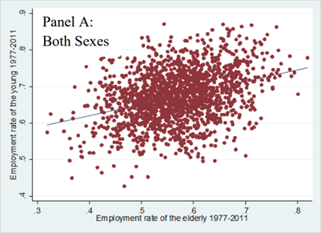
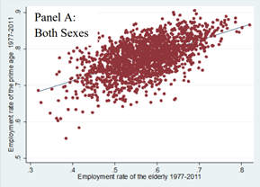
Employment rates of the elderly and the young by state over time
Employment rates of the elderly and prime-aged by state over time
Munnell, Alicia and Wu, April Yanyuan, Will Delayed Retirement by the Baby Boomers Lead to Higher Unemployment Among Younger Workers? (September 1, 2012). Boston College Center for Retirement Research Working Paper No. 2012-22. Available at http://dx.doi.org/10.2139/ssrn.2162093

Slide 6
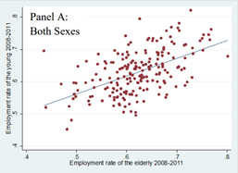
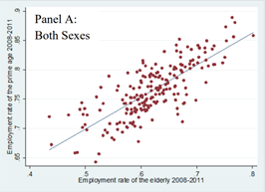
Employment rates of the elderly and the young by state over time during recession
Employment rates of the elderly and prime-aged by state over time during recession
Munnell, Alicia and Wu, April Yanyuan, Will Delayed Retirement by the Baby Boomers Lead to Higher Unemployment Among Younger Workers? (September 1, 2012). Boston College Center for Retirement Research Working Paper No. 2012-22. Available at http://dx.doi.org/10.2139/ssrn.2162093

Slide 8


Death Data from Sample
Generation | Count | 2018 Proportion | 2019 Proportion | Mean | Standard Deviation
Baby Boomer | 467 | 30.20% | 31.13% | 65.57816 | 5.052916809
Millennial | 38 | 2.30% | 2.53% | 31.76316 | 4.681384702
Gen X | 103 | 6.50% | 6.87% | 48.66019 | 4.321749369
Silent | 686 | 44.80% | 45.73% | 82.52915 | 5.168251891
Greatest | 192 | 15.50% | 12.80% | 95.0625 | 2.83882027
Other | 14 | 0.80% | 0.93% | 13.71429 | 6.069198039

Slide 11
Actuarial Model for Human Death Rate
Gompertz’ law of mortality:
Let µ_{x}=Bc^{x}
Variables
x is age; x>0
B and c are constants; 0<B<1 and c>1
The Gompertz–Makeham law states that the human death rate is the sum of an age-dependent component, which increases exponentially with age and an age-independent component.

Slide 12

Actuarial Model for Human Death Rate
x | ẻ_{x} | SD[T_{x}] | x+ẻ_{x}
0 | 71.938 | 18.074 | 71.938
10 | 62.223 | 17.579 | 72.223
20 | 52.703 | 16.857 | 72.703
30 | 43.492 | 15.841 | 73.492
40 | 34.252 | 14.477 | 74.752
50 | 26.691 | 12.746 | 76.691
60 | 19.55 | 10.693 | 79.55
70 | 13.555 | 8.449 | 83.555
80 | 8.848 | 6.224 | 88.848
90 | 5.433 | 4.246 | 95.433
100 | 3.152 | 2.682 | 103.152
These are the predicted ages of death when applying Gompertz’ law with B=0.0003 and c=1.07
ẻ_{x} is the expected lifetime of a person age x
SD[T_{x}] is the standard deviation of the lifetime T_{x}

Slide 13
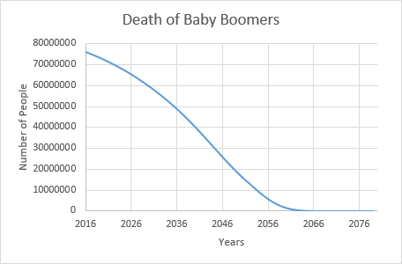
Predicted Baby Boomer Population Using Gompertz–Makeham law
When comparing our model to the Pew Research model:
The baby boomers are declining at a rapid rate.
In 2050, we predict there will only be about 17,000,000 baby boomers left

Slide 14
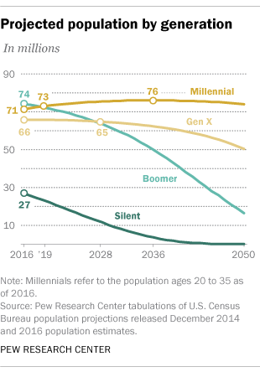
Predicted Baby Boomer Population by Pew Research
Silent Generation, dies out in about 2040
Baby Boomer population will drop to about 17 million by 2050

Slide 15
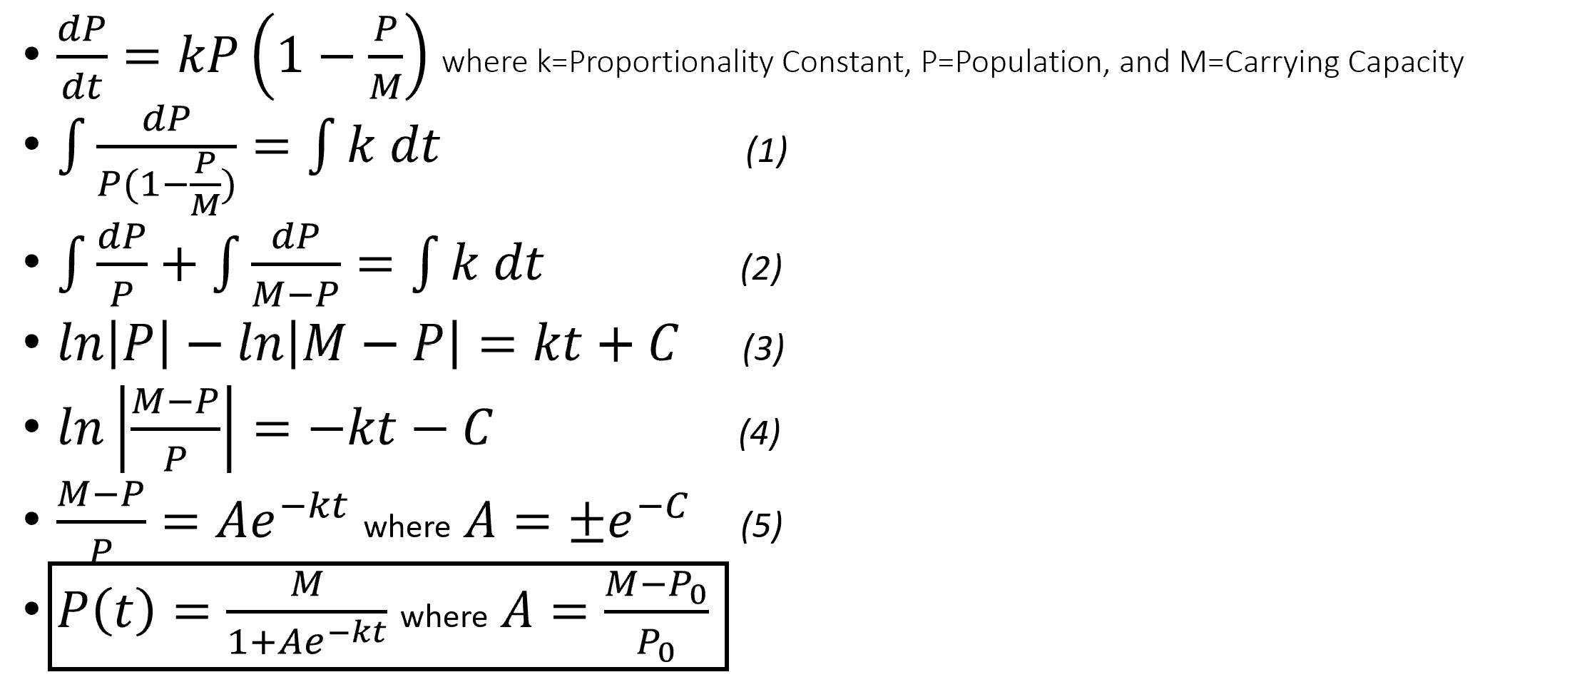
The Logistic Model for Population

Slide 16
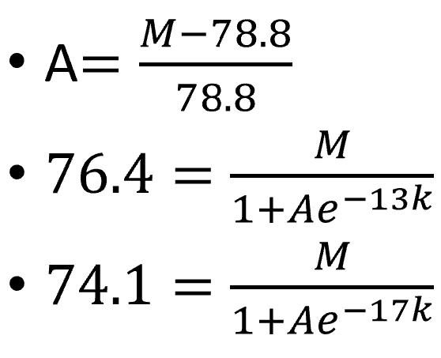
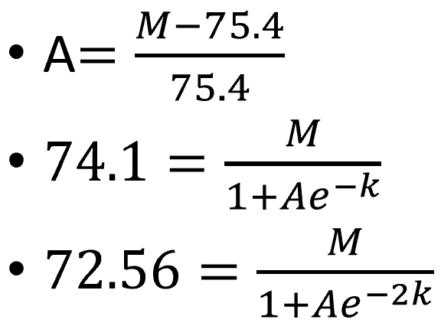
The Logistic Equation for Baby Boomer Population
P(0)=78.8m, t(0)=1999
P(13)=76.4m, t(13)=2012
P(17)=74.1m, t(17) = 2016
A=0.00455861
k=-0.159208
M=79.1592
P(0)=75.4m, t(0) =2015
P(1)=74.1m, t(1) = 2016
P(2)=72.56m, t(2) = 2017
A=0.0821967
k=-0.207812
M=81.5976

Slide 17
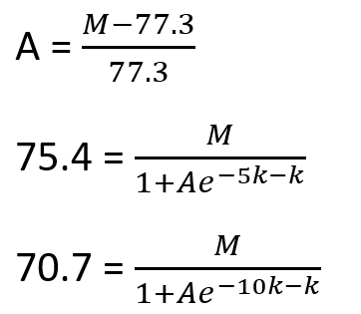
Model 1
Model 2
Model 3
P(0)=78.8m, t(0)=1999
P(13)=76.4m, t(13)=2012
P(17)=74.1m, t(17) = 2016
A=0.00455861
k=-0.159208
M=79.1592
P(0)=75.4m, t(0) =2015
P(1)=74.1m, t(1) = 2016
P(2)=72.56m, t(2) = 2017
A=0.0821967
k=-0.207812
M=81.5976
P(0)=77.3m, t(0) =2010
P(5)=75.4m, t(5) = 2015
P(10)=70.7m, t(10) = 2020
A=0.0306762
k=-0.129077
M=79.6713

Slide 18
Predicted Baby Boomer Population Using Logistic Model

Slide 19
Conclusions
Using the Gompertz–Makeham law, we predict the year the baby boomers to die out is 2080. In this year, the youngest baby boomer will be around 116 years old!
Using the logistics model, it shows that the baby boomer population may decrease slightly faster than expected, but it also still shows that we can predict the baby boomers to die out between the years 2070 and 2090.
The data from the Current Population Survey shows a strong correlation between employment of baby boomers and younger generations, but delayed retirement of baby boomers will lead to decreased wage rates for younger generations in the next recession

Slide 20
References
Devore, Jay L. Probability and Statistics for Engineering and the Sciences. Cengage Learning, 2017.
Dickson, D. C. M., et al. Actuarial Mathematics for Life Contingent Risks. Cambridge University Press, 2018.
Fry, Richard. “Millennials Expected to Outnumber Boomers in 2019.” Pew Research Center, Pew Research Center, 1 Mar. 2018, www.pewresearch.org/fact- tank/2018/03/01/millennials-overtake-baby-boomers/
“National Center for Health Statistics.” Centers for Disease Control and Prevention, Centers for Disease Control and Prevention, 29 Nov. 2018, www.cdc.gov/nchs/products/databriefs/db328.htm
“Social Security.” Reports, Facts and Figures | Press Office | Social Security Administration, Social Security Administration, www.ssa.gov/oact/STATS/table4c6.html#fn2
“Where Life Stories Live On.” Legacy.com, Legacy.com, 3 Feb. 2016, www.legacy.com/
Munnell, Alicia and Wu, April Yanyuan, Will Delayed Retirement by the Baby Boomers Lead to Higher Unemployment Among Younger Workers? (September 1, 2012). Boston College Center for Retirement Research Working Paper No. 2012-22. Available at http://dx.doi.org/10.2139/ssrn.2162093
“Just How Many Baby Boomers Are There?” Population Reference Bureau, 16 Apr. 2014, www.prb.org/justhowmanybabyboomersarethere/.
Duffin, Erin. “U.S. Population by Generation, 2017.” Statista, 9 Aug. 2019, www.statista.com/statistics/797321/us-population-by-generation/.
US Census Bureau. “Millennials Outnumber Baby Boomers and Are Far More Diverse.” The United States Census Bureau, 19 Jan. 2018, www.census.gov/newsroom/press-releases/2015/cb15-113.html.

